Slide 1

SDM COLLEGE OF ENGINEERING & TECHNOLOGY, DHARWAD
Semi-humanoid assistant
A new generation office assistant
Collaboration with: HAEGL Technologies Pvt Ltd.
Dept. Information Science and Technology
&
Dept. Mechanical Engineering
Academic Year 2020-21
Submitted By:
Parth Punekar (2SD17IS036)
Alok B Mattikalli (2SD17ME014)
Project Coordinators:
Dr. Jagadeesh D Pujari
Dr. Vandana S Bhat

Slide 2
introduction
The Project is about the Semi-Humanoid Assistant. The project is made with the collaboration with HAEGL Technologies Pvt Ltd.
The Assistant, assists in offices, institutes and other campuses, where the organization need to have separate human force for this less productive work.
The aim of the project is to automate the less productive and simple tasks done by humans, instead utilize the same human force for other productive and complex tasks where automation is not economical.
The Assistant is capable to remember the locations of the cabin and also plan the shortest route from it’s current position to the destination, i.e., the bot is intelligent.
The Assistant is embedded with intelligence for better performance.

Slide 3
Need for the study
In every organization, from start-ups to huge MNC’s, from Educational institutes to Government offices, everywhere human force is necessary for any organization to function. There is also a part of human force in all organization where the human force is not used to its fullest potential.
A part of human force is forced to do some unproductive or less productive works and eventually there is wastage of human force and intelligence.
If all the human force contributes in more productive and complex tasks, every organization may have exponential economical growth, which also benefits the nation in economical aspects as well as in infrastructure.

Slide 4
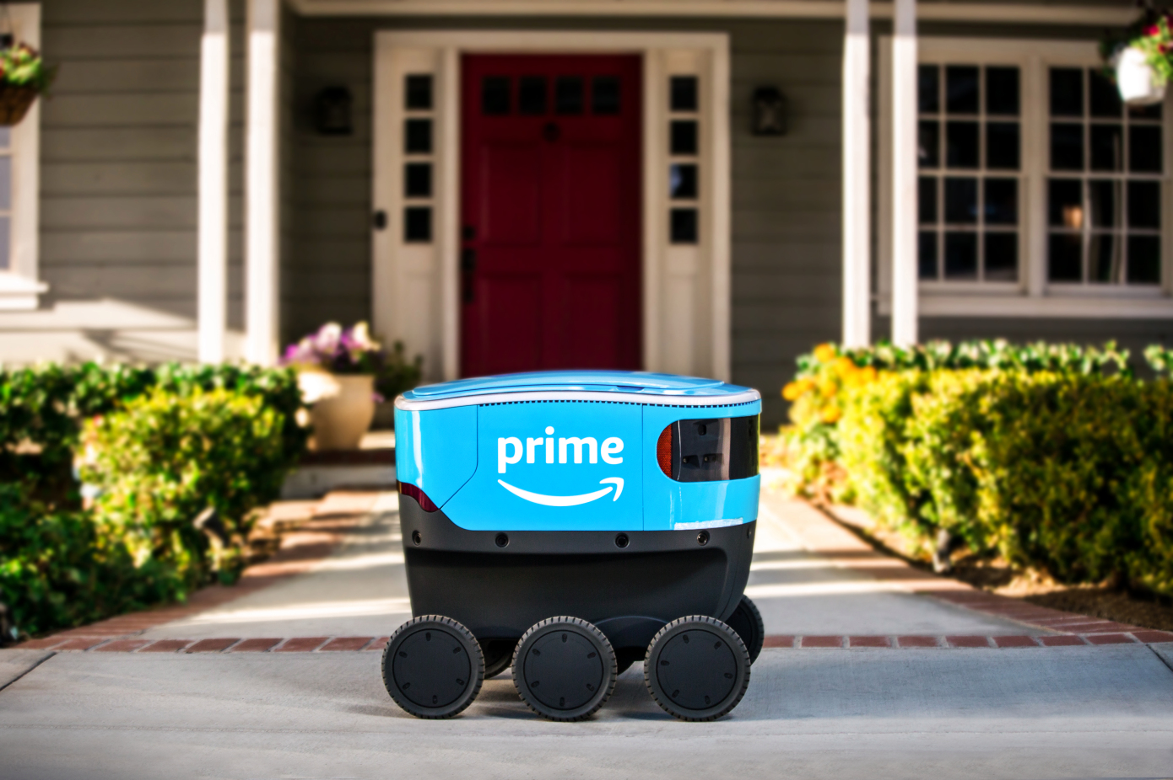
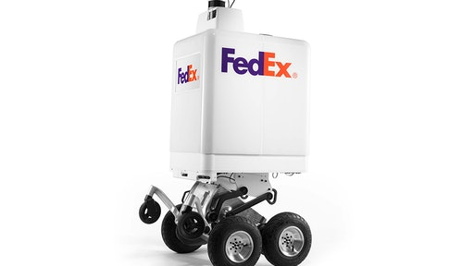
Review of literature
SameDay Bot
Manufacturer: FedEX
Brief about the bot:
SameDay Bot is an autonomous delivery device developed FedEX
This bot was designed to help retailers make same day and last-mile delivery.
The FedEX bot is developed in collaboration with DEKA Development & Research Corp. and its founder Dean Kamen.
The FedEx bot is designed to travel on sidewalks and along roadsides, and features pedestrian-safe, advanced technology such as LiDAR and multiple cameras, allowing the zero-emission, battery-powered bot to be aware of its surroundings.
These features are coupled with machine learning algorithms to detect and avoid obstacles, plot a safe path and follow road and safety rules. Proprietary technology allows it to navigate unpaved surfaces, curbs and even steps.
Scout Sidewalk Delivery Bot
Manufacturer: Amazon
Brief about the bot:
Scout is a six wheeled bot, it’s a fair bit like the number of delivery bots already being piloted on sidewalks all over the world
However, Scout was prepared in-house by Amazon
This bot is designed to deliver the stuffs in the neighbourhood and cruises along at roughly at a walking place.
This bot is designed to be used in a campus rather than in a building.
Scout also is designed to deliver food items to its customer.

Slide 5
Problem Statement
There is a lot of human stress in the corporate world. Employees work hard to meet their goals that in-turn achieves the organization goals.
We should focus on reducing the human stress by automating most of the work.
Automating tasks is not simple and relying completely on a machine to do certain complex tasks is not wise, but we can use machines to automate the simple tasks like, cleaning, pantry work, attender’s work etc.
By doing so, we can make more efficient use of human force and increase the productivity.

Slide 6
Outline of the project
Existing system:
There are many such bots developed that can deliver stuffs, but such bots are designed to operate outside the office or organization building, and mainly designed to delivery food items. Those bots are quite expensive and requires almost ideal environments to work efficiently. These bots does not the justify the high cost invested on them (not considering all the bots).
Presently if a bot has to be used in a building, then every floor of the building should have a special line, so that the bot can follow the line.
Presently for the bot to be used inside a building, then its usage is limited to a particular floor, it cannot travel from one floor to another.
Technology used (Bot Side):
Front End:
PythonGUI or JavaScript interfaced display to display the information about the bot, general information like, date, time, weather etc.
Display bot information like, battery left, source and destination etc.
Back End:
A* or Dijkstra’s Algorithm to compute the shortest path.
ROS that will help bot to move
Python scripts that controls the motion
Kinematics & Dynamics handling script, in order to move the robotic arm
Numbers learning and recognition
Natural Language Processing in order, the bot could communicate
Objectives:
To map the entire floor, also the other floors in the building
Store the map with its respective floor identification
Develop an interface that will be used to program the source and destination.
To plan the shortest route with using any guide lines (not Line Following)
Bot should be capable to operate the elevator in order to move to different floors
Communicate with the people in the office
Self charging
Motivation:
To develop a reliable system that is capable of carrying out simple tasks in offices or any intra-campus organizations, and make efficient use of human force.
System to be developed:
As there are bots to carry out simple tasks outside any organization building, we are trying to build a bot that can carry out tasks inside the building. Tasks like transferring files from one table to another, serving beverages, etc. The bot will have a Semi-Humanoid shape, that looks similar to humans.
Technology used (user side):
Font End: A web interface made with HTML, CSS, JavaScript
Back End: Python Script or JavaScript to establish and communicate with the bot.

Slide 7
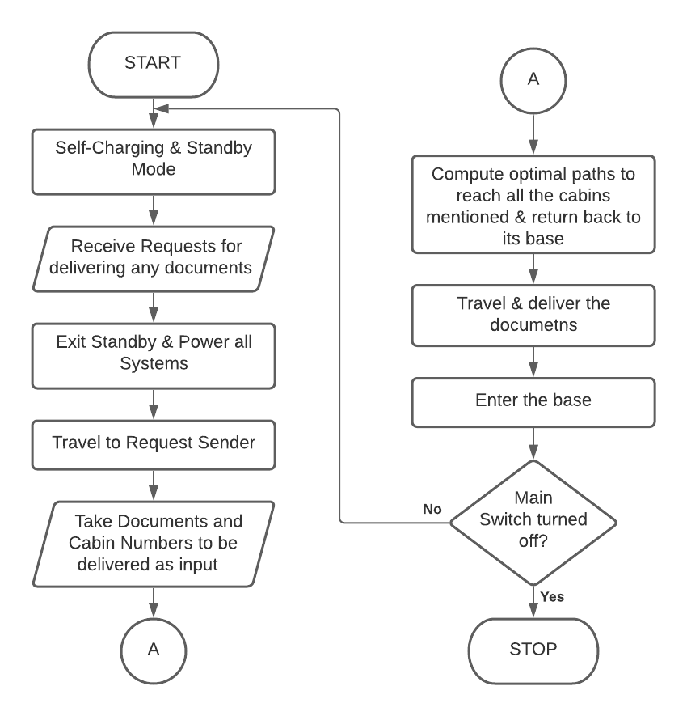

Slide 8
Applications
Automating peon tasks
Cleaning applications
Cooking Bot
Chat-Bot
Can serve as information desk
Can be used as a guide in various environments

Slide 9
Summary
Project Road Map:
Phase I (September, 2020 to December, 2020):
Design the outer body of the bot
Route mapping, saving and navigating using ROS
Number Recognition
Programming hardware to make the bot move
Phase II (January, 2021 to May, 2021):
Programming the Robotic Arm
Add voice to the bot in order to communicate with the bot
Assemble all the parts of the bot
Make test runs & solve the bugs
Final Run & Submission
Cost Estimation:
The cost estimated to develop this project is approx. Rs. 1,00,000/-, which is relatively less expensive than the present technology bots.

Slide 10
Business Model
Market Opportunities:
In large organizations, there are variety of works carried out that are simple enough and can be automated.
Automating such tasks allows organization to utilize the human force more efficiently.
The bot can be used in various applications.
The bot can be used as Peon to the organization, can serve beverages in the organization, can collect trash etc.
Using machines for simpler tasks, benefits the organization, as the work pace increases and human force contributes more efficiently to the development of the organization as well as the nation.
Value Proposition:
Primary aim the sale of the product, after sales services will also be provided.
Presently, investment on such a technology is more, but we are trying to provide at a relatively low price.
If the organization is not interested to purchase the machine, it can avail for the service, where certain number of bots will be provided on a rental basis.
This technology can also open opportunities to the human force, to explore new areas of interest.
Target Customers:
Municipal Corporation
Hospitals
Educational Institutes
Industries
Government Offices
Aviation industry
Airlines
Airports
IT Organizations

Slide 11
Assumptions & Constraints
Assumptions:
Floors in the offices are tiled, or if it is concrete then it is smooth
Every cabin is numbered & all cabins are on the same plane (i.e. there are no separate steps, or skirting to reach certain cabin)
The building has an elevator for the bot to travel to different floors
Every corner of the office has Wi-Fi connectivity (internet is not required)
Constraints:
The bot can deliver at the most to two cabins simultaneously (for prototype)
A particular bot trained in one building cannot be used in different building
The bot should have Wi-Fi connectivity to communicate (internet not required)

Slide 12
Conclusion
Semi-Humanoid Assistant can automate simple peon tasks, like, transferring files from one table to another. With some modifications, we can change the applications of the bot. The development of the bot can add to the technology, can motivate organizations to utilize human force more efficiently, also, can contribute to the Atmanirbhar Bharat motto of Hon'ble Prime Minister Shri Narendra Modi.

Slide 13
references
ROS References:
https://www.udemy.com/course/rosessentials/learn/lecture/11078886#overview
https://www.youtube.com/watch?v=mYwIu4OVMR8&list=WL&index=23&t=1s
References for Path Finding Algorithm:
https://www.youtube.com/channel/UCaO6VoaYJv4kS-TQO_M-N_g
https://www.youtube.com/watch?v=tvAh0JZF2YE
https://www.youtube.com/watch?v=ob4faIum4kQ&t=912s
https://www.youtube.com/watch?v=JtiK0DOeI4A
LIDAR Information:
https://www.youtube.com/watch?v=VhbFbxyOI1k
https://www.youtube.com/watch?v=_--8K1BW_O4

Slide 14


